Slide 1
Notes:
1

Slide 2
Anthropogenic Climate Change in Umzinyathi District Municipality
Piotr Wolski
wolski@csag.uct.ac.za
Climate System Analysis Group
University of Cape Town
Notes:
2

Slide 3
Outline of the presentation
a bit of background to Anthropogenic Climate Change
The ways climate change affects extreme weather-related events
Preliminary analysis of projected changes in climate for Umzinyathi
Implications for weather risk management and response
Notes:
3

Slide 4
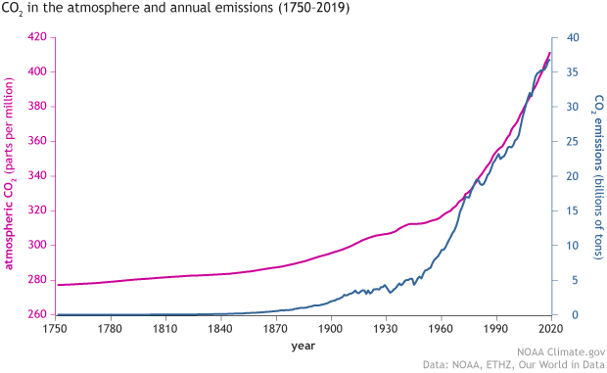
Anthropogenic climate change
The debate is over – climate change is real, caused by humankind
Carbon dioxide emissions

Slide 5
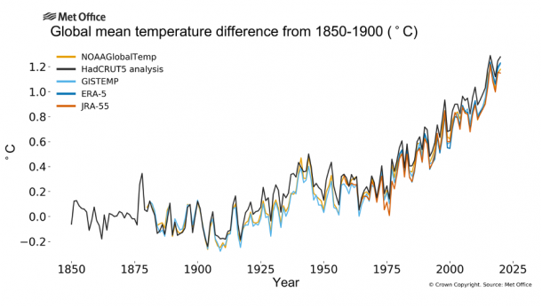
Climate Change: Where are we now?
Global mean temperature risen by 1.2 °C since 1900
Warmest period for last 10,000 years
Most of this warming since 1970s and accelerating

Slide 6
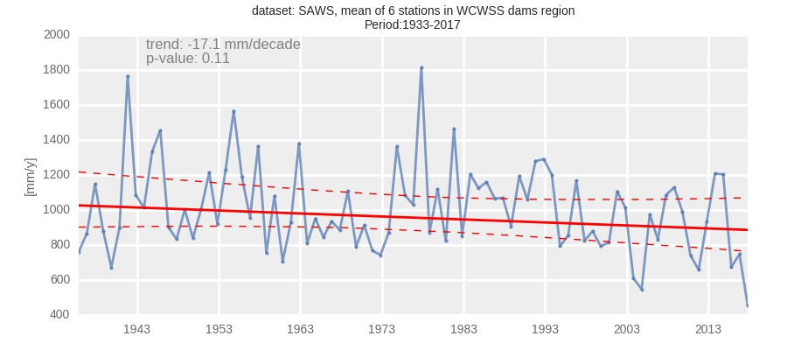
Global climate change?
Climate change is global, but manifests locally:
example: declining rainfall in Cape Town
Notes:
6

Slide 7
Climate change and climate risk
Climate change alters the likelihood of destructive weather
No climate change
Equal chance of any number
Climate change
Dice become loaded
Greater chance of higher numbers

Slide 8
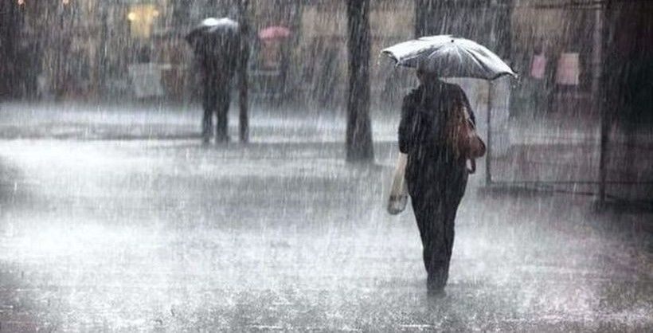
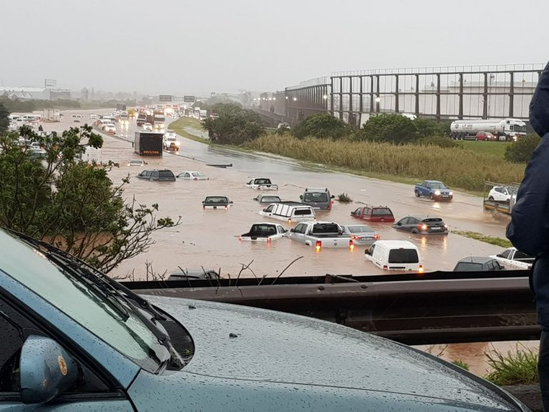
Climate change and climate risk
Climate change alters the likelihood of weather conditions
No climate change
extreme events - floods, storms, droughts - happen once in a time
Climate change
events still happen once in a time
but slightly more frequently, and with slightly higher intensity

Slide 9
Climate Change: Where are we now?
Climate has changed already, and we are experiencing impacts already!
The remaining question is:
how much will climate still change?
and
how to adapt?

Slide 10
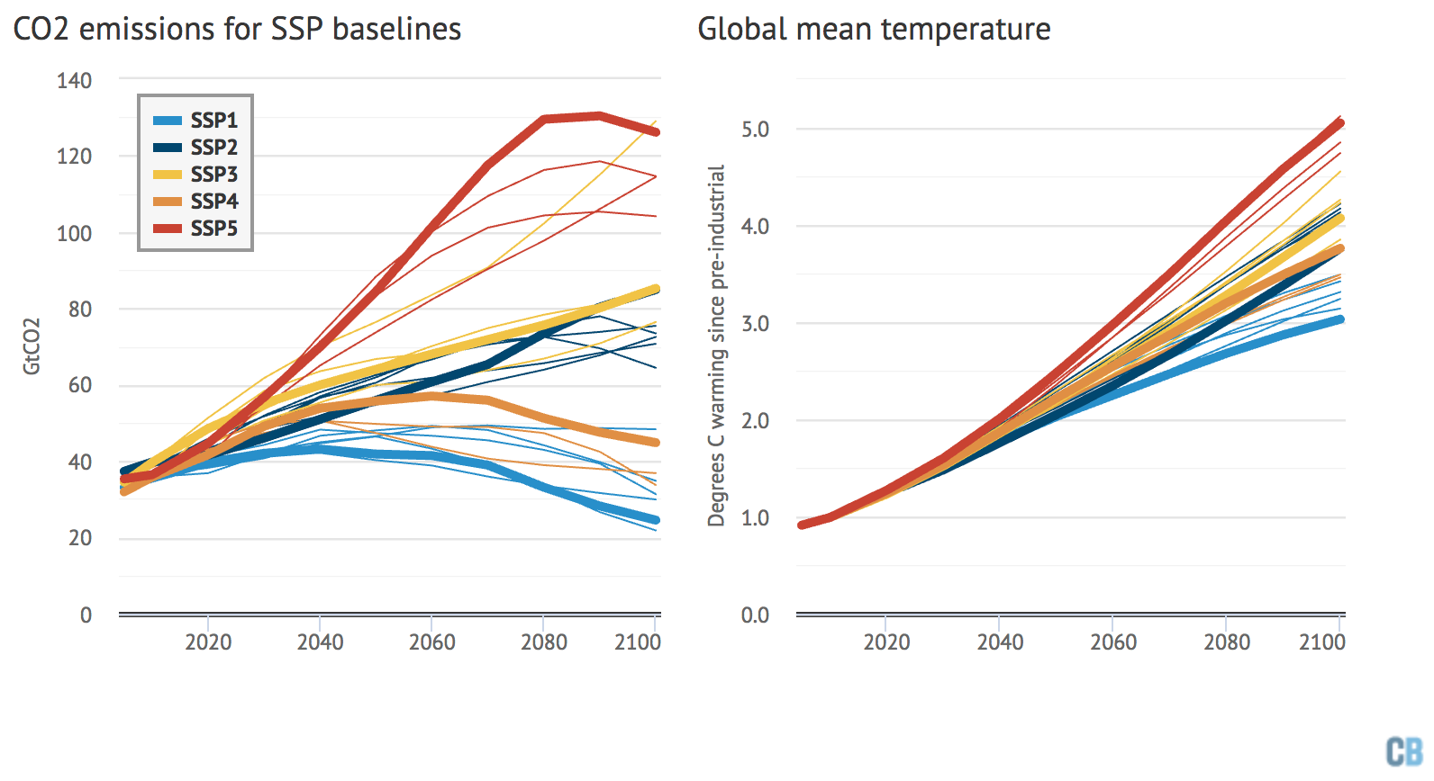
Climate Change: Where are we going?
Greenhouse gas emissions still rising
They will continue to rise - how much? depends on all of us!
Global temperature will continue to increase
Regional and local temperature and other climate variables will follow
Which future? depends on:
policies
technology
our “choices”
now and in near future
Even if we stop emitting immediately - climate will continue changing for some time!

Slide 11
Reduction of emissions - local vs. global
climate change is global, but it affects every locality
(some more, some less)
local change in emissions has little global effect
also
local change in emissions has little local effect
but
global change in emissions - requires all locations to change!
Notes:
11

Slide 12
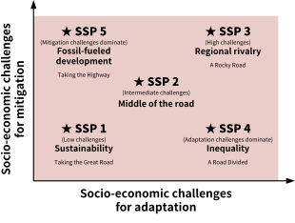
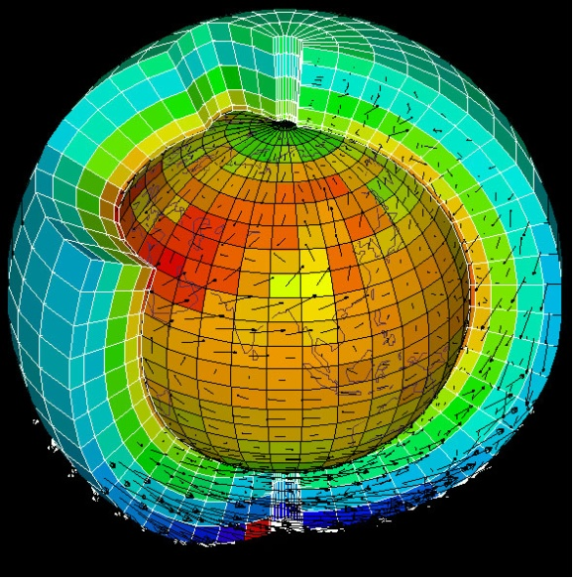
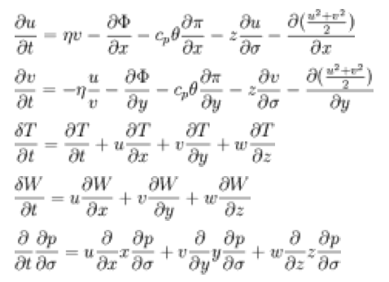
How do we predict future climate?
we use climate models - a specialized computer software
and consider current and future emissions of greenhouse gases
to generate (unfortunately uncertain) projections

Slide 13
So what do the projections say?
air temperature at Umzinyathi
We are here
(average of last 30-years)
Light Red: Climate Model Average Climate Model Range
Dark Red: Observed temperature
Notes:
13

Slide 14
So what do the projections say?
Rainfall in Umzinyathi
Dark Red: Observed rainfall
Light Red: Climate Model Average Climate Model Range
Notes:
14

Slide 15
What about events of concern? lightning
Lightning as a climate risk is not well known, unfortunately - and it requires more research
What we “more or less know” is this:
conditions for lightning increase with air humidity and a number of other meteorological variables
these increase with air temperature
~40% increase in the number of thunderstorms for every 1ºC warming
Notes:
15

Slide 16
Lightning projections
Days with conditions suitable for lightning at Umzinyathi
based on relationship between lighting and specific humidity from: Harel, M., & Price, C. (2020). Thunderstorm trends over Africa. Journal of Climate, 33(7), 2741–2755. https://doi.org/10.1175/JCLI-D-18-0781.1
Notes:
16

Slide 17
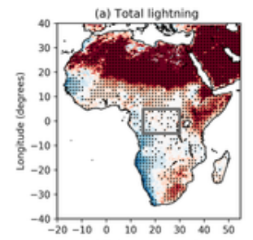
Lightning projections
Change in lightning in 2100 compared to 2000s
in a model simulation
more than 50% change!
Figure from: Finney, D. L., Doherty, R. M., Wild, O., Stevenson, D. S., MacKenzie, I. A., & Blyth, A. M. (2018). A projected decrease in lightning under climate change. Nature Climate Change, 8(3), 210–213. https://doi.org/10.1038/s41558-018-0072-6
Notes:
17

Slide 18
What about flood?
Weather Element | Influence
Precipitation events | high rainfall intensity events may exceed infiltration capacity of soil leading to overland flooding generated surface runoff channeled through the river system can lead to river flooding downstream
Air Temperature, wind, humidity | Affect evaporation, and subsequently drying of soils, may lead to increase of flooding for some soli types
Wet seasons/years | Very wet seasons lead to saturation of soils and increase likelihood of excess water in high intensity events, leading to flooding.

Slide 19
Non-climatic factors in flood risk
Factor | Influence
storm drainage | may be under-designed, or poorly maintained - leading to blockage and flooding
land management | deforestation, urbanization in headwaters - lead to loss of surface retention and increased storm runoff leading to local or downstream flooding
overgrazing | leads to exposure of soil and loss of surface retention, leading to excess storm runoff and local or downstream flooding
wetland loss | loss of water retention and likely downstream flooding
dam operations | dams, when full, lose function of flow regulation, leading to downstream flooding
others...

Slide 20
Flood and climate change
Flood as a climate risk is well researched, and dependent almost exclusively on rainfall.
In general - atmospheric physics indicate that warming leads to increase in extreme rainfall and thus flooding.
(warmer air can hold more moisture, and that can be rained more rapidly)
Unfortunately, however, there is a large uncertainty in projecting future rainfall.
Notes:
20

Slide 21
What about flood?
Intensity of rainfall events at Umzinyathi
There is quite some uncertainty, but higher than currently intensities dominate, suggesting higher likelihood of flood
Notes:
21

Slide 22
Messages from previous, country-wide climate change assessment:
Extreme rainfall events in summer rainfall region of South Africa show
a tendency towards increasing in frequency annually,
and especially in spring and summer,
with a reduction in extremes in autumn.
Notes:
22

Slide 23
Projected changes in Umzinyathi weather
Summary of initial analyses:
Rainfall – uncertain, but wetter future seems more likely
Temperature – warming trend
Increasing lightning risk into the future highly likely
also, increase in weather drivers of flood is likely
droughts cannot be excluded!
Additional analysis that could be done:
development of a locally-specific, comprehensive lightning projections
evaluation of flood risk with a comprehensive hydrological model, accounting for climatic and non-climatic factor

Slide 24
Implications of Climate Change for Adaptation
lightning
enhancement of behaviours that avoid exposure to lightning
Infrastructural interventions???
flood
storm drainage improvement and maintenance
informed flood-sensitized land management practices, locally and in headwaters
wetlands preservation and management
avoiding construction in floodplains
Other actions???

Slide 25
Thank you
Notes:
25

